Slide 1
RK307
Detection of Child Predators &
Cyber Harassers on Social Media
By: Team Cryptonite

Slide 2







MEET THE TEAM
PRATISHTHA
DANIEL
KOMAL
SHIVANGI
KABIR
MANIKA

Slide 3
Problem Description
Online predators try to gradually seduce their targets through attention, affection, kindness, and even gifts, and often devote considerable time, money and energy to this effort. They are aware of the latest music and hobbies likely to interest kids. They listen to and sympathize with kids' problems. They also try to ease young people's inhibitions by gradually introducing sexual content into their conversations or by showing them sexually explicit material.
• Desired Solution : The solution will detect suspect profiles based on child grooming behavior patterns followers, hate speech provokers, stalking and bullying mentality profiles and explicit content explorers ( postings, comments) on social media platforms and other websites.

Slide 4
TECHNOLOGY STACK USED
Python
Flask
JavaScript
HTML
CSS
Bootstrap
MongoDB
React
Django
Machine Learning
ReconnectingWebSocket

Slide 5

SOLUTION
Data Scraping and Collection
Detection of Sexual Predators
Reporting and Retraining
Data Cleaning and Preprocessing
Hate Speech and Cyberbullying Detection
We have collected data from various sources, such as scraping Twitter data, from existing datasets on Kaggle and other websites.
Sexual predators groom potential victims and exploit vulnerable people. To prevent, our classifier can detect the grooming stage and accordingly take action.
Users can be warned, and suspicious profiles can be blocked and reported to the police. Users may also report undetected instances, which will continuously improve the accuracy of our model.
2
4
1
3
5
Data in the real world is always dirty. Thorough cleaning and preprocessing had to be done before any language processing was done.
The first stage of classifiers works to detect instances of cyber bullying and hate speech propagation before it can become a menace.

Slide 6
Module 1:
Detection of Child Predators on Social Media

Slide 7



The parent module has been divided into 3 Sub-Modules
Sentiment and Content Analysis
TOPIC MODELLING: LDA
Textual Analysis:N-Grams
1
3
2

Slide 8
Sub Module 1:
Topic Modelling - LDA

Slide 9
Topic Modelling:
An Unsupervised Learning Technique
Key Features
Involves counting words and grouping similar word patterns to infer topics within unstructured data.
We have made use of Latent Dirichlet Allocation (LDA) to do topic analysis of the chat conversations.
The goal of LDA is to determine the mixture of topics that a document contains. Each document is represented as a distribution over a fixed number of topics, while each topic is represented as a distribution over words.

Slide 10
APPROACH AND IMPLEMENTATION
Construct an LDA model over chat conversations corpus
Based on the model, find topic distributions across all messages in the corpus and in the test conversation to generate topic vectors of length 12 (number of topics per document) where each value represents the probability of presence of a topic in that document.
Once the topic vectors are ready, we use them to find a cosine similarity score between the messages of convicted predators and test messages (unlabelled conversation)
A higher cosine score signifies a greater topic similarity to predator’s conversation.
Assign a stage label to text message based on majority vote out of the top 3 messages most similar to the test message.

Slide 11
Approach and Implementation
Construct an LDA model over chat conversations corpus
Once the topic vectors are ready, we use them to find a cosine similarity score between the messages of convicted predators and test messages (unlabelled conversation)
1
3
2
Based on the model, find topic distributions across all messages in the corpus and in the test conversation to generate topic vectors of length 12 (number of topics per document) where each value represents the probability of presence of a topic in that document.
4
A higher cosine score signifies a greater topic similarity to predator’s conversation.
Assign a stage label to text message based on majority vote out of the top 3 messages most similar to the test message.
5

Slide 12
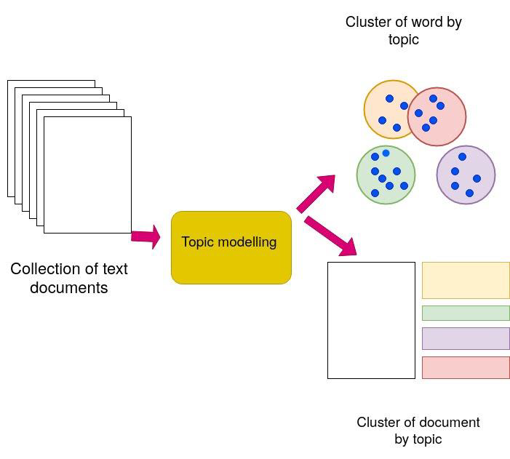

Slide 13
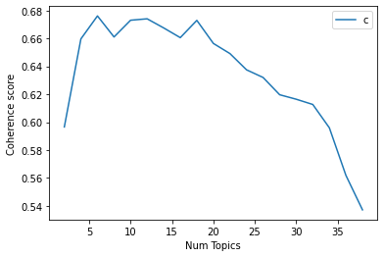
Number of Topics per Message
From the graph, we found the suitable number of topics for our model to be 12

Slide 14
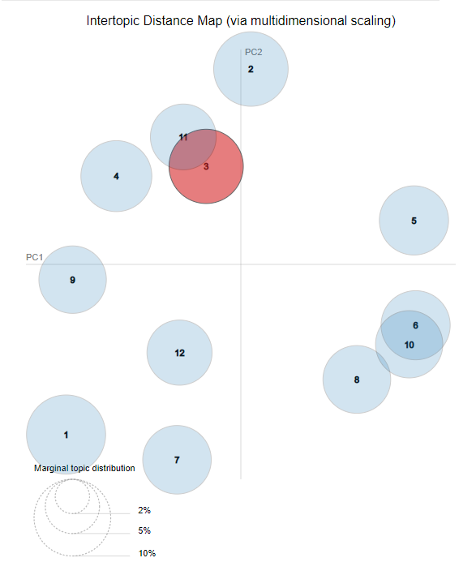
The intertopic distance map shows that our topic model is decently constructed with well-spaced non overlapping topic distributions.

Slide 15
Performance Metric of LDA Model
Topic coherence judges how good a given topic model is.
The higher the coherence, the better is the model.
Our model recorded a coherence score of 0.61, which is an indication of a good topic model.

Slide 16
Sub Module 2: Sentiment and Content Analysis

Slide 17
Features Used:
Sentiment Analysis Score: In order to determine whether the message is malicious in nature.
Subjectivity Score: To better factor in the subjectivity and the contextual nature of language itself.
Complexity Score: In order to understand how convoluted the message is.
Readability Score: A modified Fog Gunning Index was used to better suit the needs of the project.
Length of Messages

Slide 18
Models Tried Out:
Logistic Regression
Decision Trees
Support Vector Machines
Naive Bayes
Final Model Used:
Logistic Regression: Based on precision and recall values after optimization using Grid Search

Slide 19
Performance Metric of Logistic Regression Model
Any machine learning model can be evaluated on the basis of several parameters like accuracy, precision, recall, and, F score etc..
The logistic regression model in this case has given a steady performance with around 50% accuracy.
Even though the accuracy is sub par, the precision, recall and F1 score values have been observed to be over 80% each which indicates that the model is a good and trustworthy classifier

Slide 20
Sub Module 3:
Textual Analysis - NGrams

Slide 21
NGRAM MODULE
NGrams are basically the co-occuring words within a given window and in our model we have used ngrams in the range (1,3), i.e. monograms, bigrams and trigrams.
For this, TFIDFVectorizer is used which results in a csr format sparse matrix which is then converted to a dense matrix of mxn dimension. The dense matrix is then used as the predictor for the prediction of stages of each conversation in the chat.

Slide 22
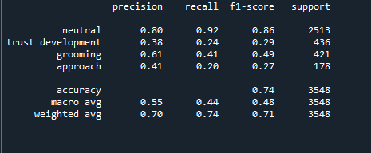
NGRAMS: Classification Report

Slide 23
Integration of Modules for Detecting Child Predators

Slide 24
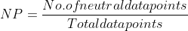
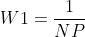
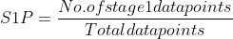
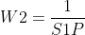
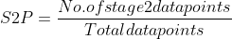
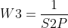
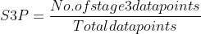
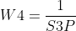
Formula Table

Slide 25
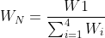
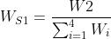


W_s1 is the weight for stage 1
W_s2 is the weight for stage 2
W_s1 is the weight for stage 3

Slide 26
Module 2:
Hate and Offensive Speech Detection

Slide 27
Features Used with Random Forest Classifier:
Textual
POS
Calculated

Slide 28
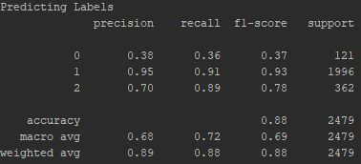
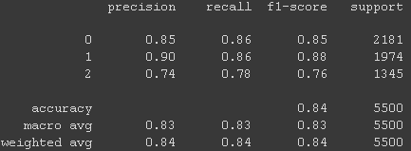
Improvements after Dataset Expansion
Before vs After

Slide 29
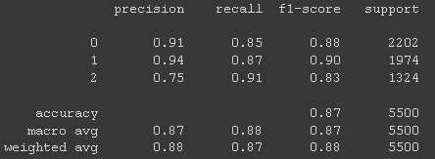

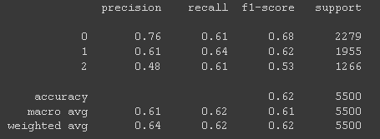
Single Classifier vs Multi Classifier
(Text, POS, Calculated)

Slide 30
Single Classifier vs Multi Classifier
Confusion Matrices
 | Hate | Offensive | Neutral
Hate | 1869 | 103 | 209
Offensive | 123 | 1701 | 150
Neutral | 219 | 83 | 1043
 | Hate | Offensive | Neutral
Hate | 1875 | 81 | 246
Offensive | 106 | 1720 | 148
Neutral | 78 | 35 | 1211

Slide 31
Database used &
Working of threshold
MongoDB backend utilised to store user details and user score and profile metadata
Score updated with each new text that the user sends in a particular conversation
Threshold value set as 0.15 as revealed from calculations performed
Score stored always checked against threshold to check for incorrect behaviour on the internet

Slide 32
RISK FACTOR CALCULATION

Slide 33
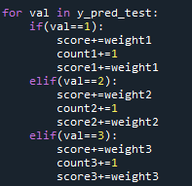
Average of stage 1 is calculated by - score1/score
Average of stage 2 is calculated by - score2/score
Average of stage 3 is calculated by - score3/score
Risk factor majorly occurs for stage 2 and stage 3.
So, modified_average=Average-threshold
If modified_average is positive =>value is above threshold, the stage will be considered for risk.
Risk % = (Modified_Average/Average)*100
We’ll take the stage giving maximum risk percentage.

Slide 34
User Interface

Slide 35
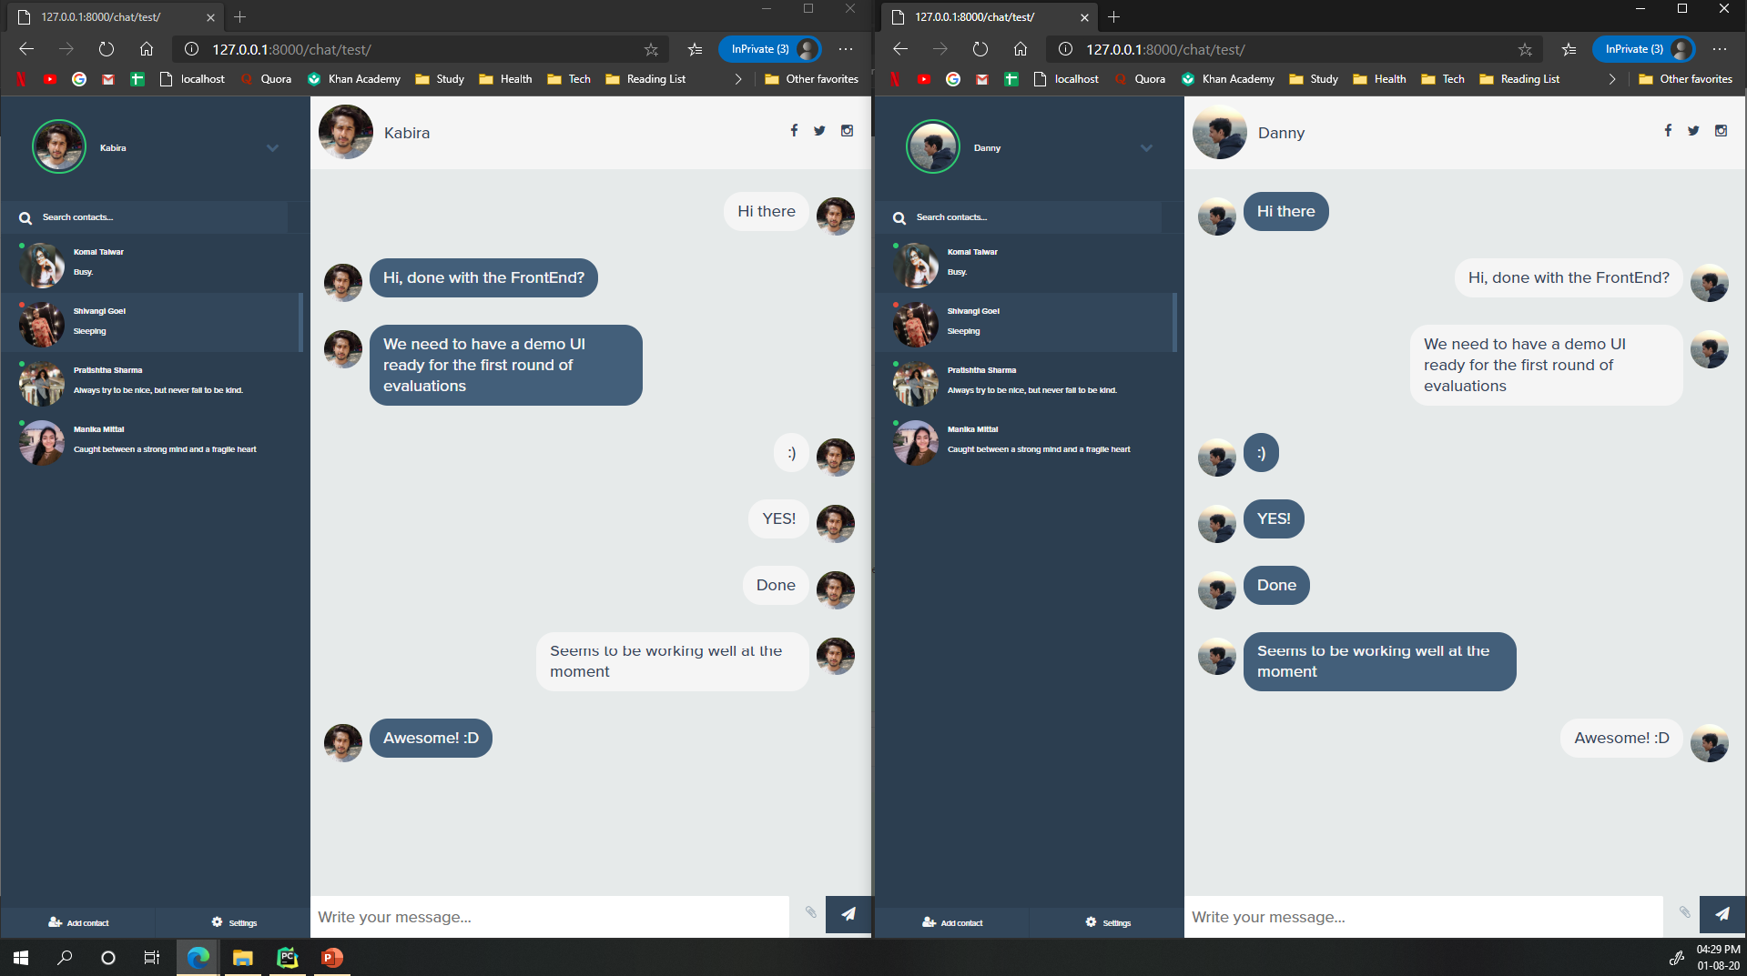

Slide 36
Report Generation

Slide 37
Dynamically Generated Reports
Generated by polling database based on unique registration ID on chat website.
Data from connected social profiles may also be added.
FPDF used to generate a pdf dynamically and saving it directly
Score based on threshold utilised to filter out texts that are relevant for the report
Texts labelled as ‘Grooming’ and ‘Approach’ approaching the threshold are added to the evidence report.

Slide 38
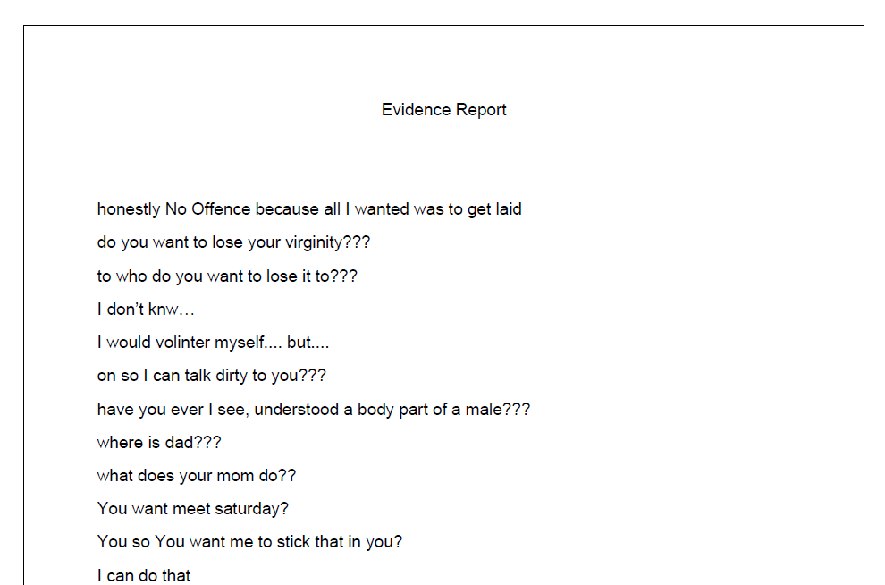
SAMPLE EVIDENCE REPORT

Slide 39
Model Improvements

Slide 40
A static model is a useless model
The idea is to ensure that the model continually improves.
Although our focus has remained on clamping down on false negatives, those instances which escape the watchful eye of our model can be added back to the model to improve its accuracy once the user reports or flags a conversation as being inappropriate.
Similar methods may also be adopted to reduce unnecessary flagging of profiles (false positives).

Slide 41
Thank you.

